Slide 1
Illustrative Results an Overview of a Randomized Evaluation of REAP and Livestock Asset Protection Program (IBLI)
Helen Dalton
July 2018

Slide 2
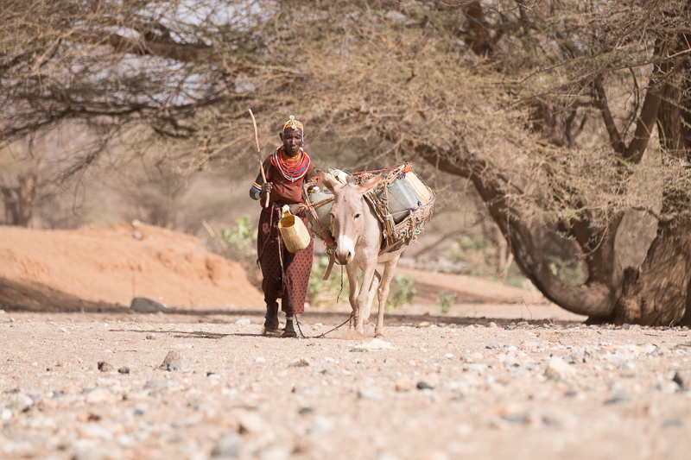
What we do
High-impact, gender-focused poverty graduation program

Slide 3
The BOMA Poverty Graduation Model - REAP:
Two-year program of sequenced interventions
Defined exit strategy
Data driven
Clear measures of success

Slide 4
The REAP graduation model
Resilience Leading to Self-Reliance
6
Linkages: formal financial and market connections
Program Graduation
Two Years of Mentoring
5
Savings and Access to Credit
3
Business and Life Skills Training
1
2
4
Targeting
Conditional Cash Transfer
Pre-intervention
0 months
6 months
1 year
2 years
Notes:
BOMA has flipped the traditional graduation model, starting with a cash transfer and income generating activity first instead of starting with savings.
No consumption smoothing

Slide 5
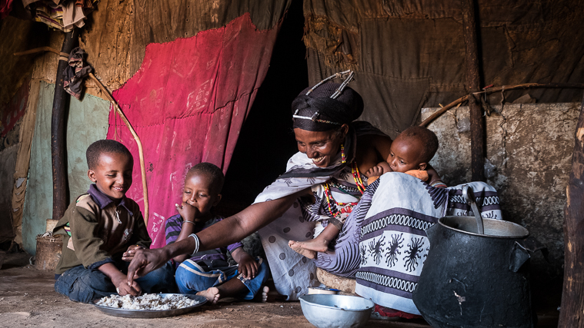
Our Goal
Increased resilience of households
Women have a greater role in households and communities
Reduce the global cost of relief efforts through disaster aversion
Notes:
Climate change triggers severe drought in pastoral lands and drives families deeper into poverty.
Gender-focused programs build resilience and give families the resources to withstand shocks.
Resilient families uplift themselves and their communities, building a pathway out of extreme poverty
Disaster aversion is more cost-efficient than humanitarian post-crisis aid.

Slide 6
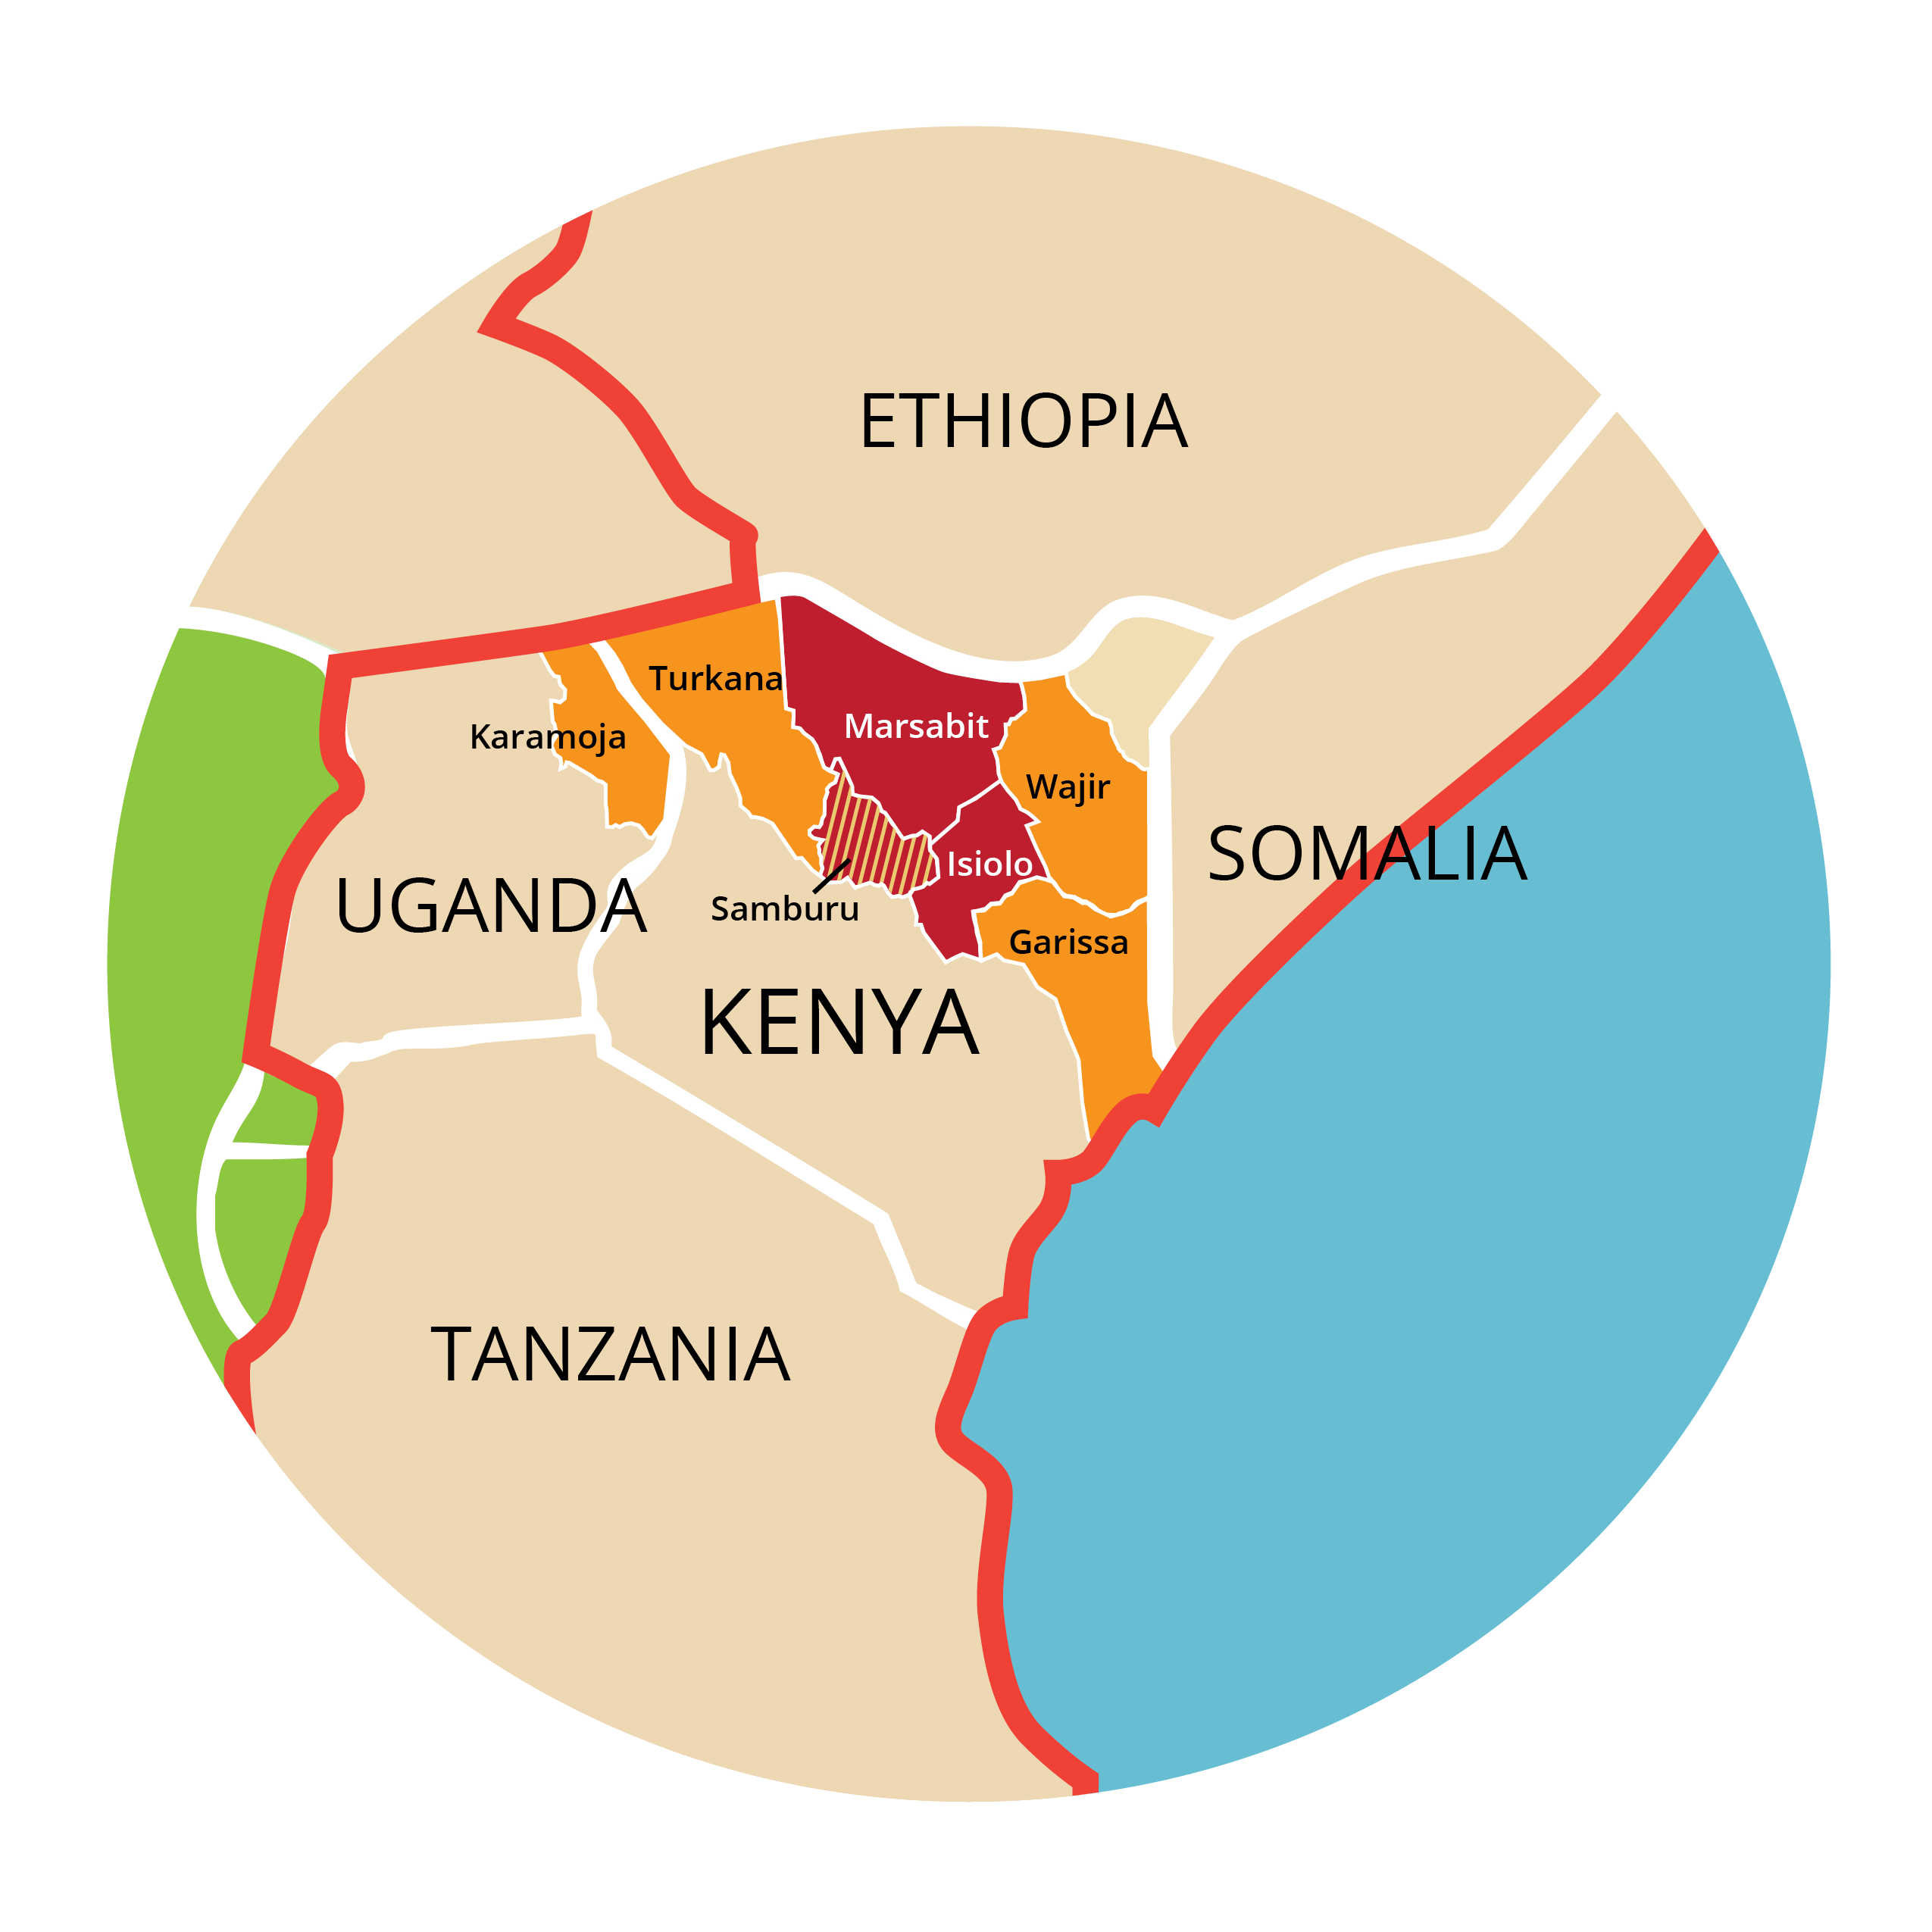
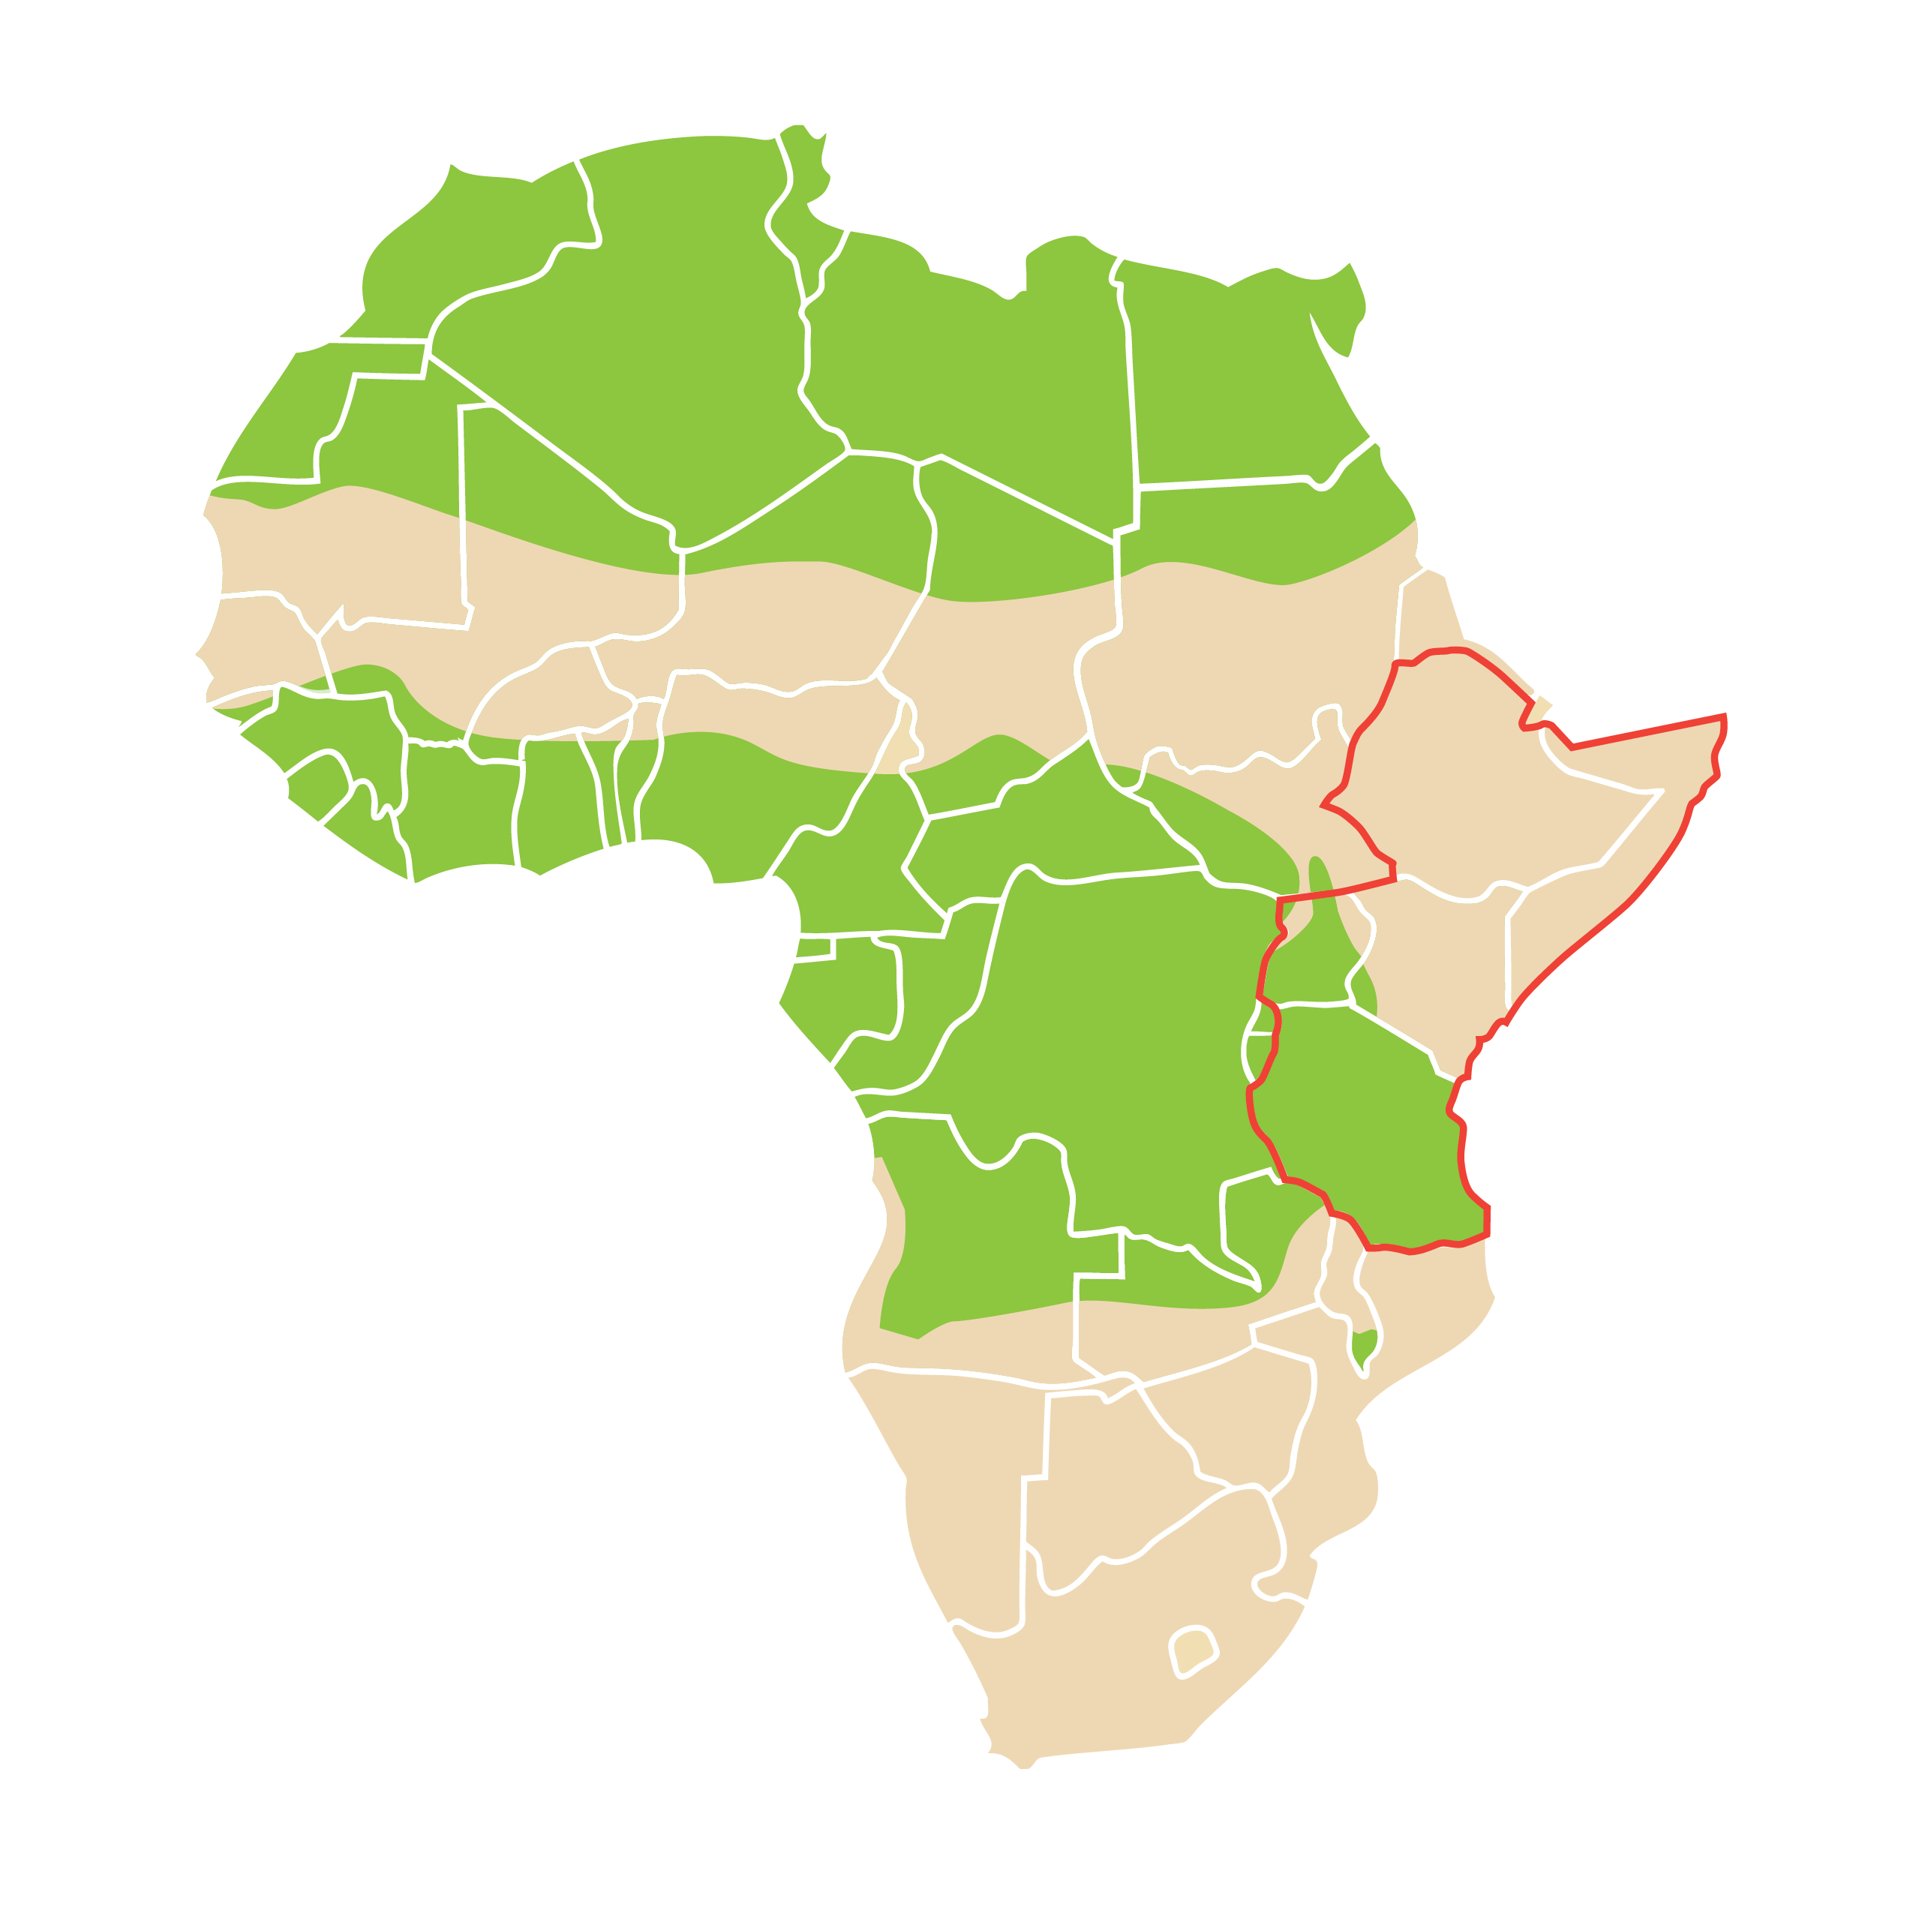
Where We Work
6 counties in Kenya; one district in Uganda

Slide 7
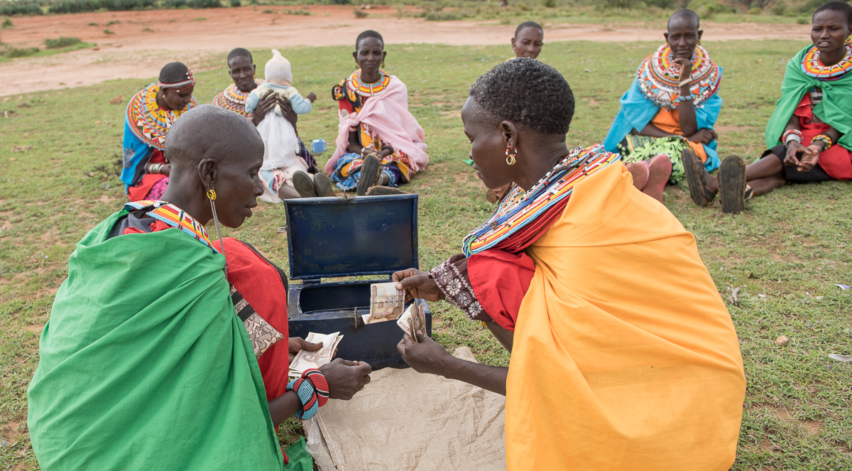
REACH
Since 2009 enrolled over 15,000 women and launched over 5,000 businesses
In 2017 enrolled 4,555 women in REAP and provided ongoing mentoring to 9,100 women
In 2017 supported 427 active savings groups

Slide 8
Graduation Criteria
Food security
No child going to bed without an evening meal
Household members eat two meals a day
Sustainable Livelihoods
Productive asset base/value of the BOMA business is 25% higher than the total of original cash transfer
Participant can access multiple productive assets (i.e. a business, livestock)
Notes:
Graduation Programs have a defined entrance and exit strategy with clear definitions of success

Slide 9
Graduation Criteria
Shock Preparedness
Member of a savings group (with formal constitution and credit and loan protocols), has access to credit, min of KES 8000 in committed savings.
Human Capital Investment
All eligible primary school-aged girl children are enrolled in primary school
Participant has an increased role in household decision making

Slide 10
Results from a 2016 – 2018 Cohort in Marsabit
Project design
750 Women enrolled and formed 250 business
Each initially received a cash transfer of KES20,000 to form a business, as well as a mobile phone and mpesa enabled SIM card
All groups received monthly mentoring visits BOMA village mentors
After 6 months business groups received an additional KES 10,000
5 businesses came together to form 51 savings groups
Continues to receive mentoring for 18 months
Notes:
To give an idea of REAP results…

Slide 11
Results from a 2016 – 2018 Cohort in Marsabit
Demographic characteristics
72% married
Average age 39, with majority b/w 21 – 40 years
89% have no formal education but 93% functionally numerate
Average household size is 4 and almost all households (98%) have children living in the household
Notes:
Graduation Programs have a defined entrance and exit strategy with clear definitions of success

Slide 12
Results from a 2016 – 2018 Cohort in Marsabit
Economic Outcomes – business performance
All but one of the businesses still in operation at exit
94 % of the active businesses meet the graduation criteria of having a business value of at least 125 percent of the initial grant size (KES 37,500).
At exit 70.6 % of the groups are running small shops (Kiosks/Dukas) as their primary businesses,
Groups with livestock as primary businesses show the highest average value
Notes:
Some of the results

Slide 13
Results from a 2016 – 2018 Cohort in Marsabit
Economic Outcomes – savings and credit
Participants contributed an average of KES 521 per month
Participants reported significantly higher total savings at exit (14,510 KES) compared to baseline (KES 785, p< 0.0001), representing an increase of 1748% percent over the two years in REAP.
# of participants who reported taking out loans over the past year doubled
Main reason for taking a loan was for household consumption
Notes:
Graduation Programs have a defined entrance and exit strategy with clear definitions of success

Slide 14
Results from a 2016 – 2018 Cohort in Marsabit
Economic outcomes – income, expenditures and livestock ownership
REAP households with more than one source of income increased from 65% at baseline to 96% at endline
154% increase in expenditures on school-related expenses
Highest expenditure is on food, although expenditure on health has also increased
TLU owned by the household increased from 3.5 TLU to 8.5 TLU and those owned by the participant increased from 1.1 to 3.1
Notes:
Graduation Programs have a defined entrance and exit strategy with clear definitions of success

Slide 15
Overall Graduation Outcomes (May 2016 – April 2018 Marsabit cohort; 750 women)
Category | Baseline | Midline | Endline
Food Security
1. No child going to bed without an evening meal in the past week | 42.8 | 76 | 98.5
2. Household members eat two meals a day in the past week | 80.0 | 96.7 | 99
Sustainable Livelihoods
3. Value of business is 25% higher than total conditional cash transfer | N/A | 65 | 95.9
4. Participant can access more than one source of income | 64.9 | 80.5 | 96.4
Shock Preparedness
5. Participant is a member of a savings group, has access to credit, and has a minimum of KES 8,000 in savings | 2.0 | 23.2 | 99
Human Capital Investment
6. All eligible primary-school aged girls are enrolled in primary school | 56.7 | 60.6 | 68.5
Overall Graduation Rate | N/A | 4.2 | 40.4
Graduation rate (Excluding HCI) | N/A | 10.6 | 90

Slide 16
Randomized Evaluation of REAP and IBLI
Research Objectives
Measure the impact of REAP and IBLI separately on the extent and depth of poverty at the community level, over time.
Compare those impacts to the impacts of a package that combines both REAP and IBLI.
Identify optimal implementation designs for meeting the programs’ objectives cost-effectively
Notes:
…. SO While there is evidence that REAP and IBLI are individually effective in the short and medium term – both programs have the potential to complement each other.
by:
Testing how to encourage uptake of IBLI through different insurance subsidies, and
Evaluating economic and social spillovers through tests of program saturation

Slide 17
REAP/IBLI Study
Hypothesis
REAP outcomes on income, food security, savings and well-being will be enhanced by livestock insurance that prevents participants from backsliding during drought.
Notes:
While there is evidence that REAP and IBLI are individually effective in the short and medium term – both programs have the potential to complement each other.
Hypothesis in regards to combining the two programs is that REAP outcomes on income, food
security, savings and well-being will be enhanced by insurance that prevents participants from backsliding during drought and other shocks

Slide 18
REAP/IBLI Study
Research Methodology
5 year (2017 – 2022) randomized, controlled trial to evaluate program impacts and sustainability.
Divides participants into four treatment arms: REAP, IBLI, REAP + IBLI, and control (no treatment).
Variable saturation design - to enable the researchers to evaluate economic and social spillovers by front-loading the delivery of REAP in some project communities and back-loading the delivery of REAP in others.

Slide 19
REAP/IBLI Study
Research Methodology
Participants will be enrolled in five waves (420 per wave), with initial enrollment dates separated by six months.
Takaful Insurance agents will provide some REAP participants and some better-off community members with coupons for free or subsidized livestock insurance.
Varying insurance subsidy rates will enable researchers to understand how to most cost-effectively encourage uptake of IBLI.

Slide 20
REAP/IBLI Study
Timeline | Date
REAP targeting & survey sampling: | Jan. 2018
Baseline survey: | Feb. 2018
Insurance sales launches: | Feb. 2018
REAP launches: | Mar. 2018
Midline survey: | Feb. 2020
REAP graduation (the first wave): | Feb. 2020
Midline report: | Aug. 2020
Endline survey: | Feb. 2022
Endline report: | Aug. 2022

Slide 21
REAP/IBLI Study
Policy Implications
Implications for design of integrated social protection systems that can promote the graduation of poor households from extreme poverty while simultaneously providing safety nets to protect vulnerable, non-poor households (including recent graduates) from descent into extreme poverty.

