Slide 1
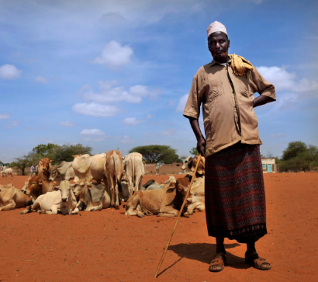
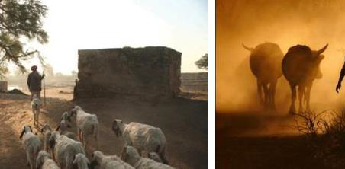



Lessons from Implementing Livestock Insurance in Kenya and Ethiopia
Duncan Khalai, Market & Capacity Development Specialist
International Livestock Research Institute
Tanzania Insurance Regulatory Authority (TIRA) conference
Dar esalam – 18th July 2018

Slide 2
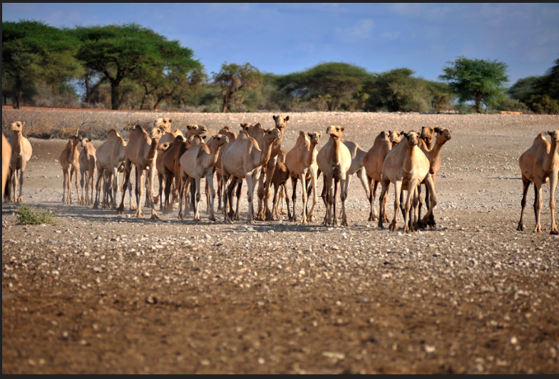
Components of a Sustainable Index-Insurance Program
Precise contract design;
Evidence of value and impact;
Establishing informed effective demand;
Low cost, efficient supply chain;
Policy and institutional infrastructure.

Slide 3
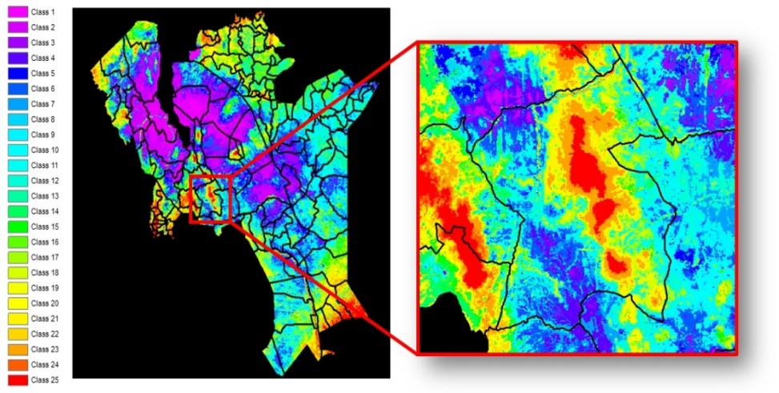
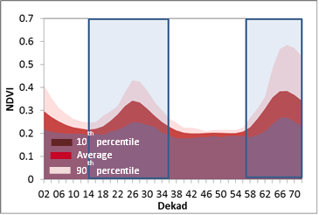
Precise Contract Design
Balance between precision (basis risk, value-addition), and simplicity (technical scaling, capacity building)
Capacity to design, understand and administer contracts requires concerted and institutionalized capacity building – beyond tools and training.
Continuous contract refinement; new technologies, data sources, and means of validation could result in considerable improvements in contract precision – E.g. IBLI shift from asset replacement to asset protection
Implementation & scale up requires careful analysis - Not all regions are equally suitable with regard to seasonality

Slide 4
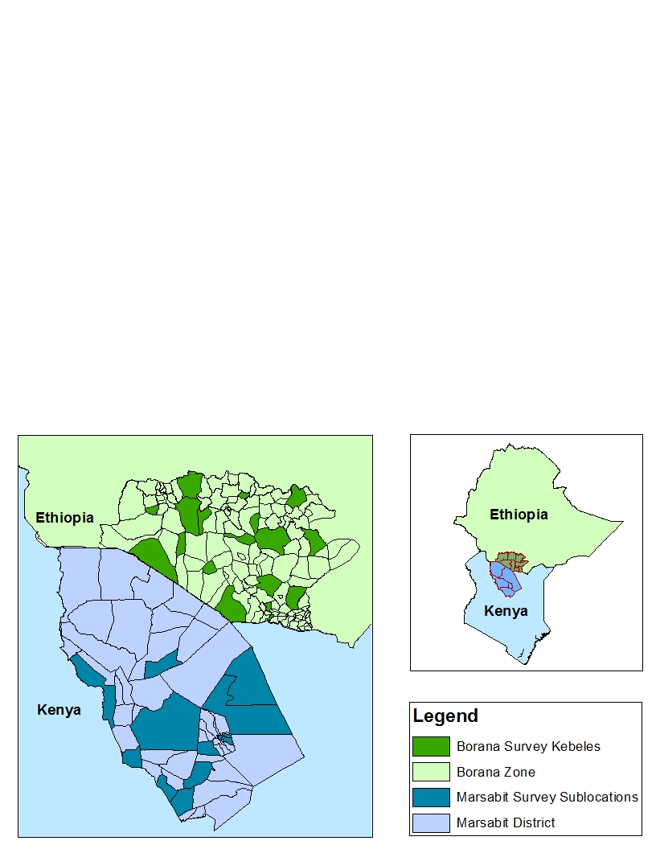
Evidence of Impact and Value
Methods:
Panel survey for impact assessment e.g. ILRI has done 6 rounds since start of IBLI implementation in 2010
Monitoring Evaluation and Learning surveys and interactions
Evidence:
Wide range of positive household impacts
Quantification of risk-coverage precision of contracts
Indication of value-for-money for public expenditure
For references refer to https://ibli.ilri.org/publications/
Notes:
List of positive household impacts

Slide 5
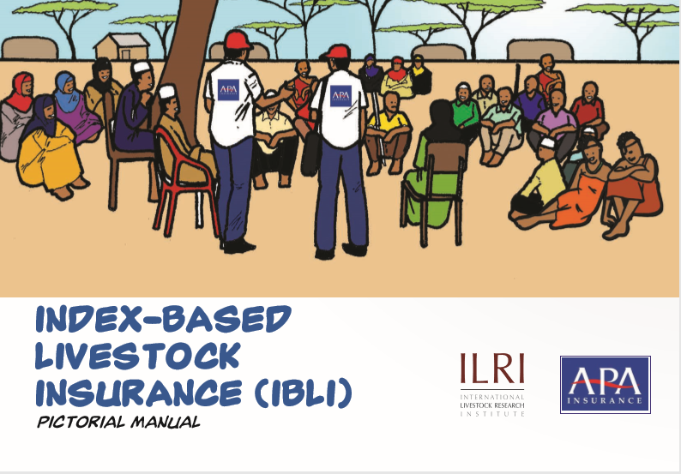
Establish Informed Effective Demand
Capacity Development, Training, Extension and Marketing at:
Policy level - Facilitate supportive Environment in regulation, institutional and policy support, technical assistance, ombudsman
Service delivery level – Building capacity of public and private sector e.g. government, Insurance companies, Insurance regulatory Authority e.t.c
Public (client/beneficiary) level - Client needs to understand the product and trust the delivery mechanism.
Notes:
Three-tier cap dev strategy targeting all critical constituents

Slide 6
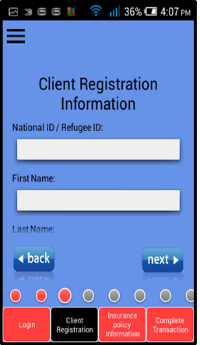
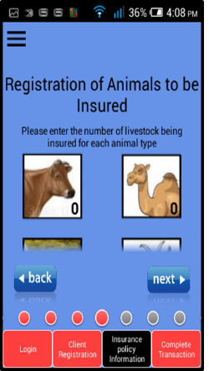
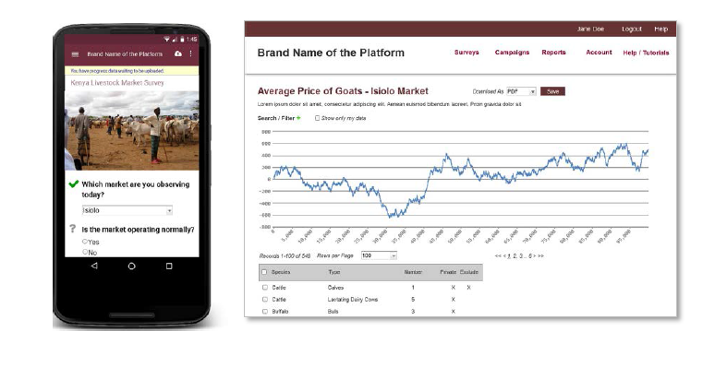
Low-cost, Efficient Delivery – KLIP Implementation
Leverage digital technology for cost efficient and effective service delivery
Examples:
Mobile based sales applications
Mlearning solutions
eLearning solutions
Electronic registration
Mobile money for pay-outs
Index monitoring app

Slide 7
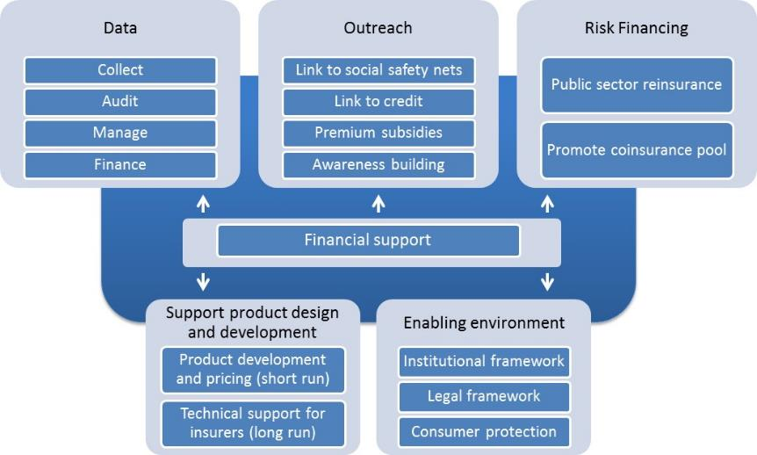

Policy and Institutional Structure
Sustainable, large-scale index insurance program requires a clear and well articulated policy structure
What are the key roles for each sector?
Example: 2012 the Government of Kenya set up the National Agricultural Insurance Policy Taskforce → Situational Analysis and recommendations for program development.
Multiple actors with various functions have been engaged in implementation i.e. ILRI, World Bank, Insurance Regulatory Authority, Private sector (Insurance companies), Banks, Telecommunication companies

Slide 8




























The IBLI Program is a Collaboration of Many Players
IBLI Policy and Academic Workshop – July 2015

