Slide 1
KENYA LIVESTOCK INSURANCE PROGRAM
Sharing KLIP Experiences with the Government of Tanzania
19/7/2018
Richard Kyuma, PhD., OGW
KLIP Program Coordinator
State Department of Livestock

Slide 2
Contents
Justification - Why Livetock insurance
KLIP design and project area
Implementation Progress and Achievements
KLIP Activities
Workplan and Budget
Expected outcomes/impacts
Public private partinerships
Challenges
Lessons learnt and way forward

Slide 3
Big Four Agenda
Food Security and nutrition.
Manufacturing
Health
Housing
KLIP Strategies for attainment of Food security and nutrition
Building Resilience through insurance in the pastoral areas
Promotion of PPP

Slide 4
KLIP
A PARTINERSHIP BETWEEN GoK, WORLD BANK,
ILRI AND PRIVATE INSURANCE COMPANIES
IMPLEMENTATION BY THE STATE DEPARTMENT OF LIVESTOCK
WORLD BANK AND ILRI PROVIDE TECHNICAL SUPPORT
PRIVATE INSURANCE COMPANIES PROVIDE INSURANCE COVER AND PAYOUT TO BENEFICIARIES

Slide 5
Justification for Livestock Insurance
Kenya is vulnerable to frequent and extremely expensive natural disasters;
High frequency of drought (every 2-4 years);
2008 - 2011: Total drought losses to Kenyan economy: KShs 968.6 billion and reduction of GDP by 2.8% each year. 72% of this loss is related to livestock;
Severe droughts lead to approximately 20% mortality of livestock;

Slide 6
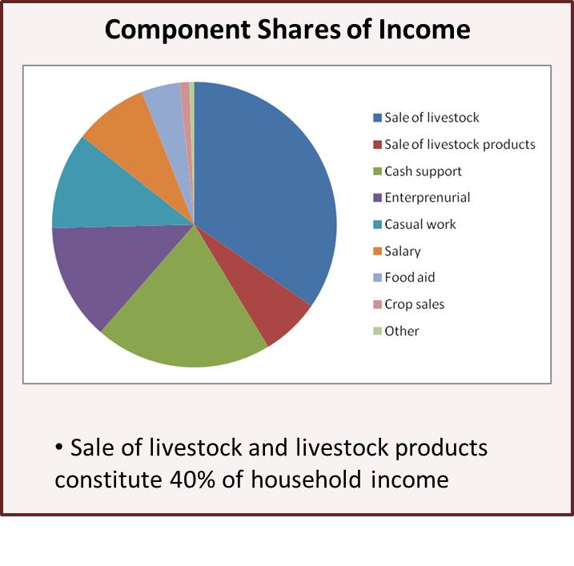
KLIP JUSTIFICATION
Livestock is the principle asset and key source of income in pastoral Economy
Data source: Project baseline 2009 (924 Marsabit Households)
Notes:
6

Slide 7
KLIP OBJECTIVES
To build the resilience of vulnerable pastoralists in the Arid and Semi-Arid Lands (ASALs) against the consequences of drought through the the provision of index based livestock insurance services to the vulnerable pastoralists
To build capacities of the pastoral communities and stakeholders on the use of insurance for the reduction of weather related risks and rebuilding of livelihood support systems;
To increase Public-Private-Partnerships (PPP) in the provision of index based livestock insurance to the vulnerable pastoralists whose livelihoods are dependent on livestock. KLIP will endeavor to support private sector to provide insurance services in the ASAL’s through innovative subsidy support mechanisms and use of county extension delivery systems to enhance awareness on insurance;

Slide 8
KLIP Design
Designed to use forage availability as determined by satellite data - Normalized Difference Vegetation Index (NDVI) to determine whether to pay;
Following the successful piloting of ILRI designed IBLI
Currently the National government provides 100% premium support for 5 tropical livestock units (TLU) belonging to vulnerable pastoralists;
The insurer and beneficiaries will make arrangements for desired additional cover;
The insuring company makes payouts directly to the accounts of the beneficiaries when there is a trigger.

Slide 9
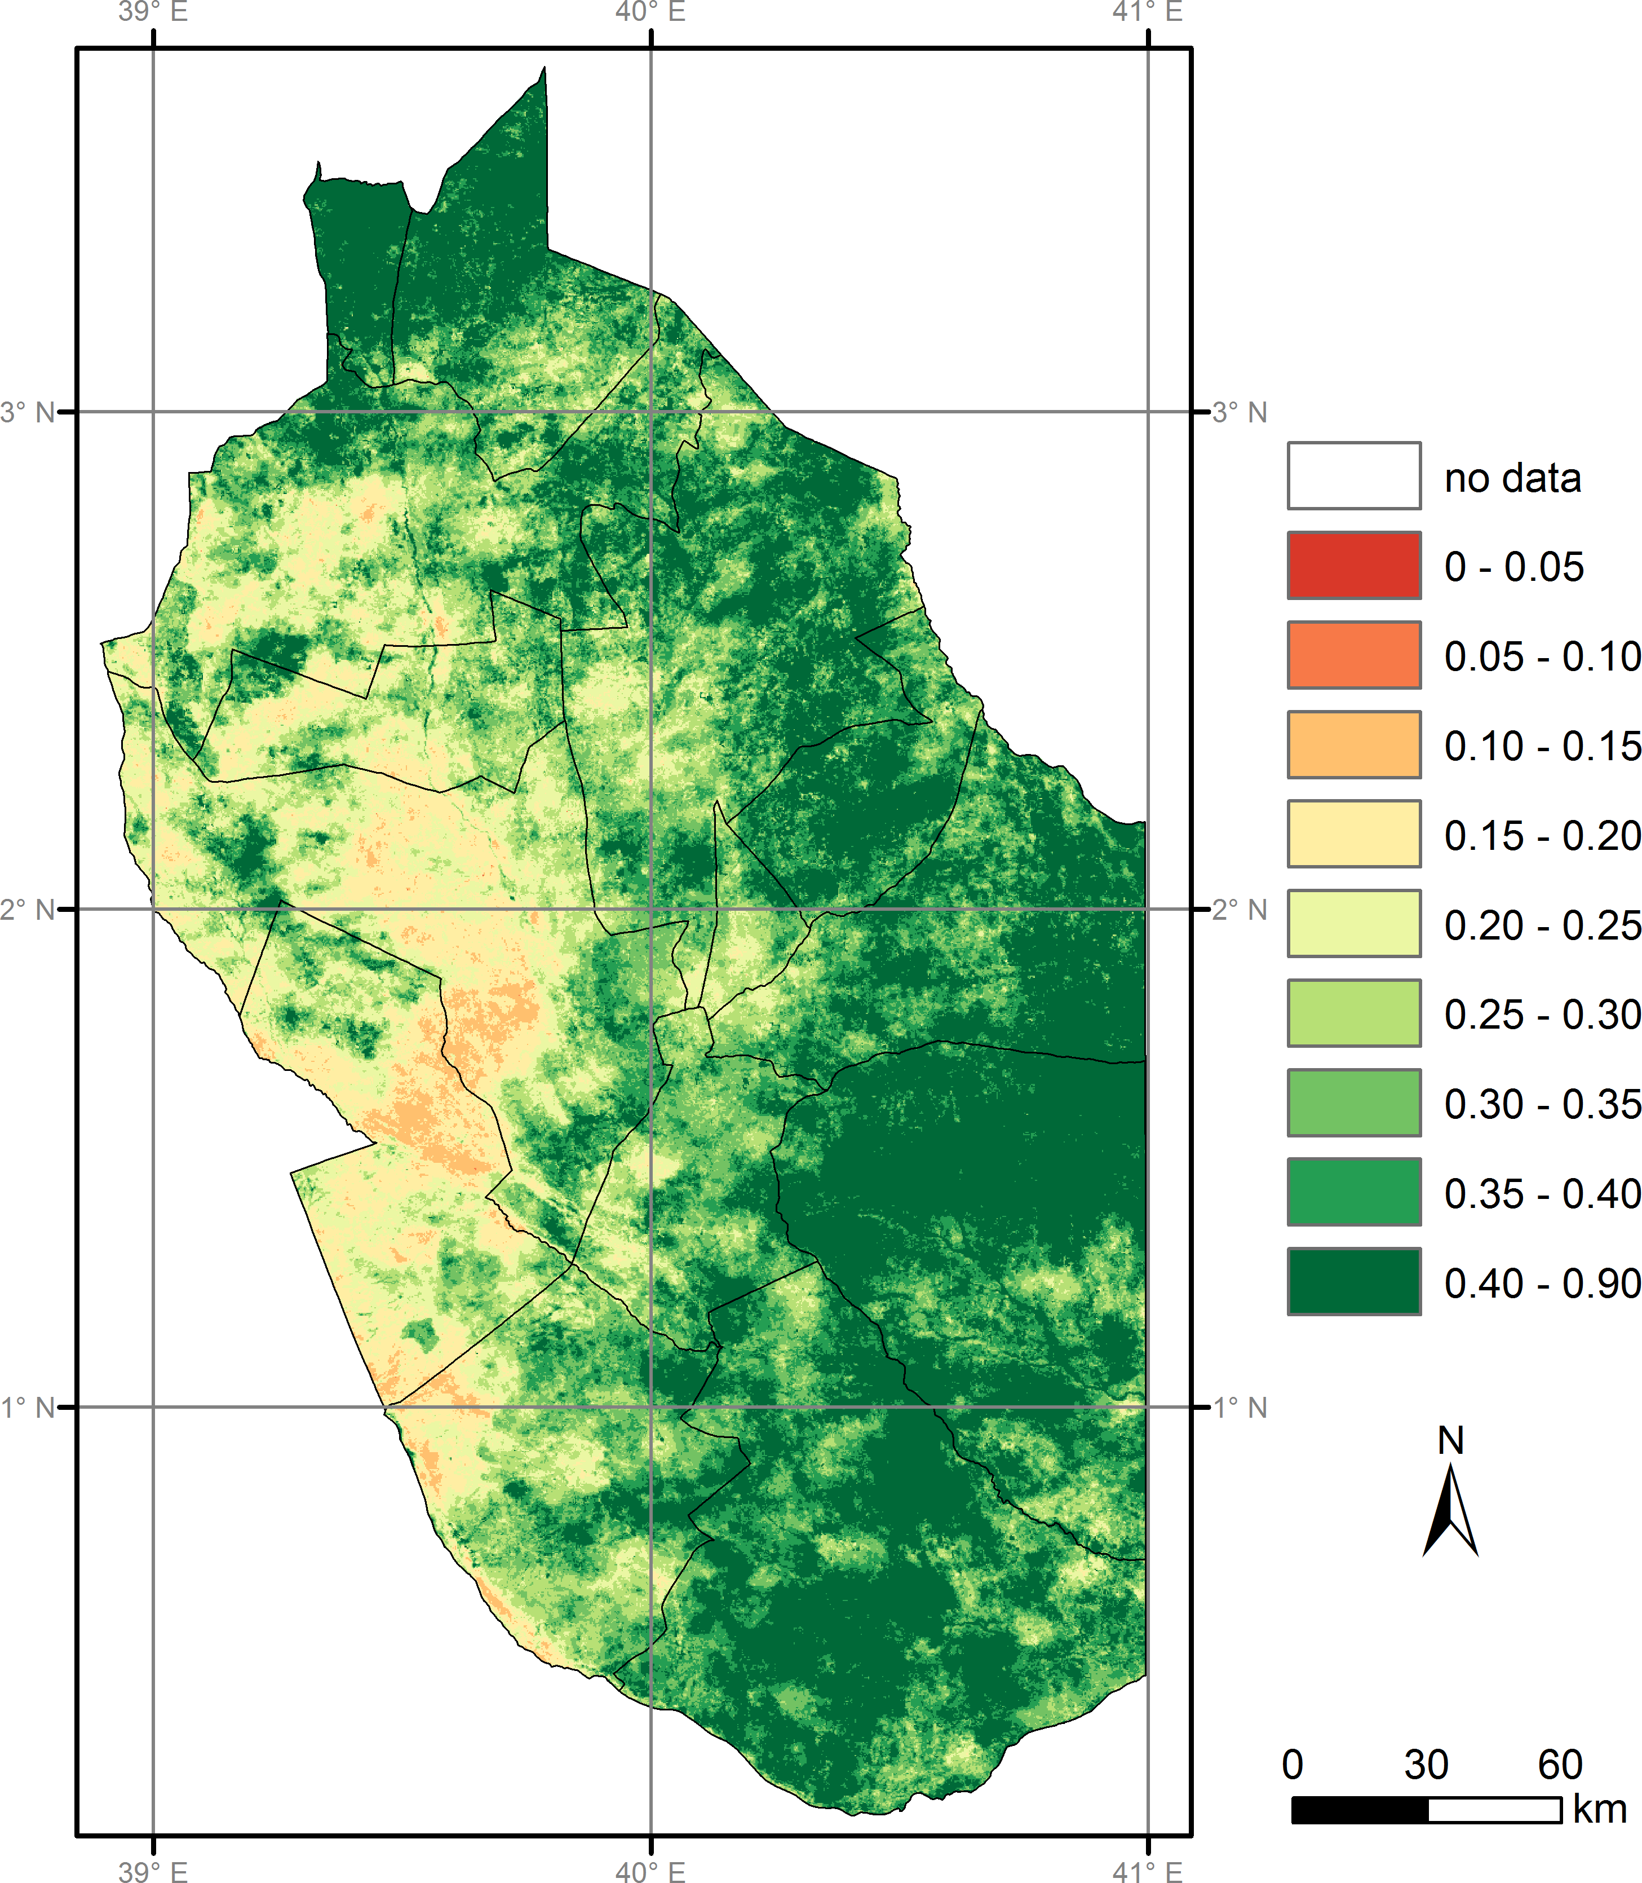
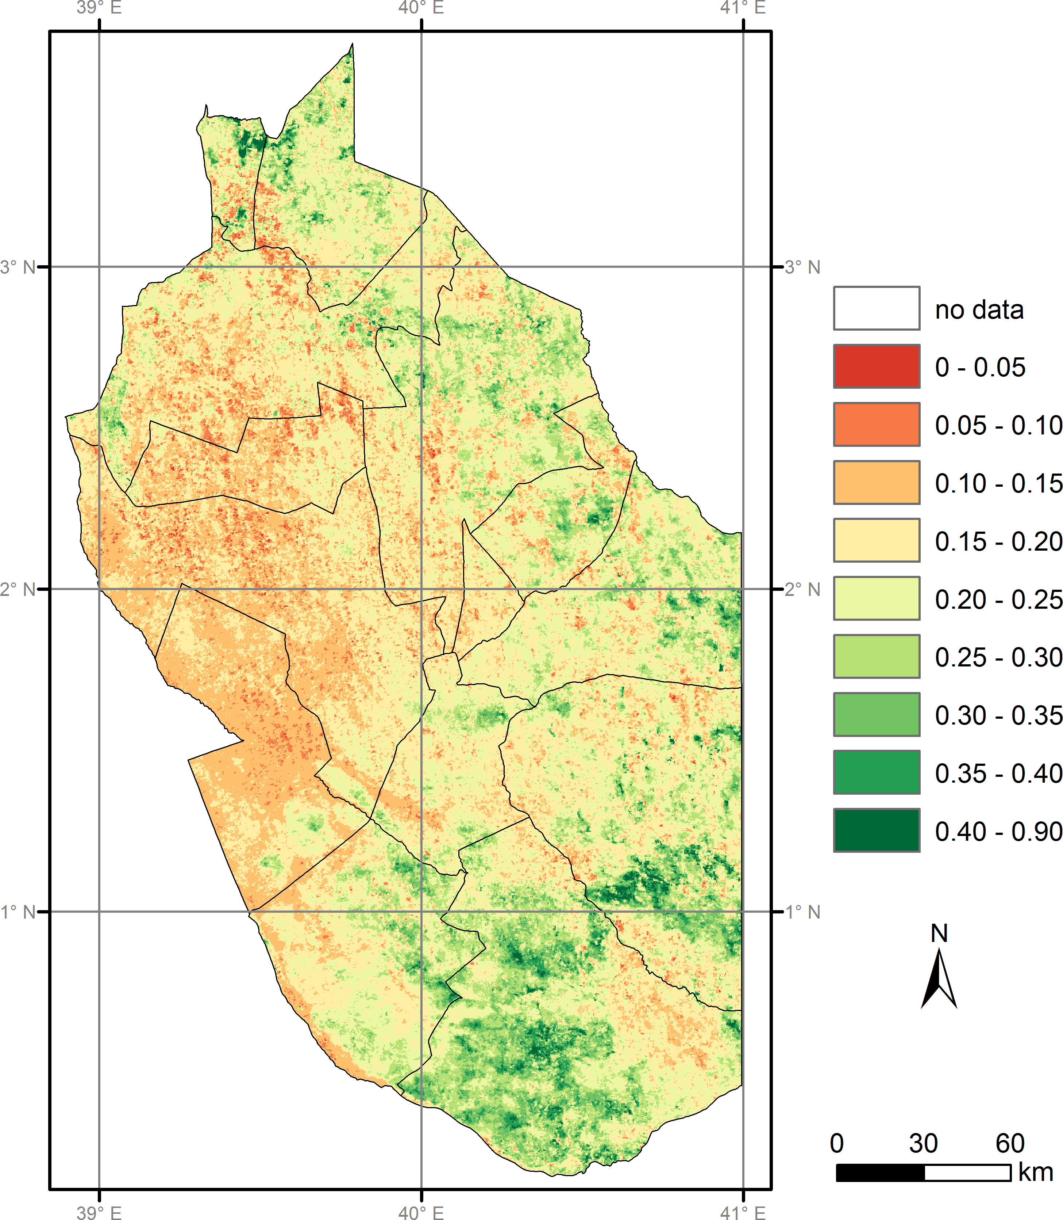
Use of Satellite Data
Generation of Relevant Satellite Data (NDVI)
1-10 May 2010
1-10 May 2011

Slide 10
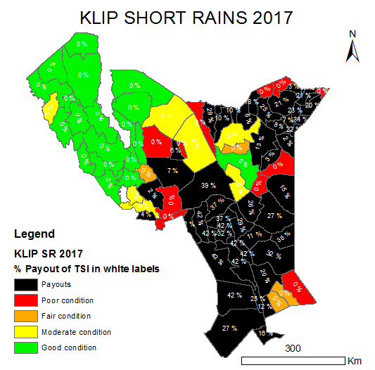

Slide 11
Legend for the state of KLIP/IBLI Index
The KLIP color legend below describes the state of the index in a simple and easy to understand format.
Green | Good forage availability. Represents between 65th -100th percentile of forage conditions over time. This is above normal and stable forage condition.
Yellow | Forage conditions fall between 45th to 65th percentiles. Here, the forage situation is around or slightly above normal.
Orange | Forage conditions are between 30th and 45th percentile. The division in question is below long term average but conditions are not yet serious.
Red | Forage condition is between 20th – 30th percentiles. Drought situation is serious but not yet classified as severe. At this stage, indemnity will have NOT been triggered.
Black | Severe drought conditions. Forage condition are below the 0-20th percentile. Indemnity payout have been triggered .
Payouts are made only if the index is below the 20th percentile
For the February 2016 period, payouts triggered for Diff and Bute Divisions only

Slide 12
KLIP Coverage
The Program is to cover 14 ASAL Counties of
Turkana, Wajir , Marsabit, Isiolo, Tana River, Mandera ,
West Pokot, Baringo, Garissa and Samburu
Laikipia, Narok, Kajiado and Lamu
Upto September 2017, six counties of Turkana, Wajir, Marsabit, Isiolo, Tana River, Mandera were under cover.
Currently insurance contract for 8 counties including Garissa and Samburu and samburu has been signed and took effect from October, 2017
On Average 2000 households covered in each county except, Turkana, Wajir, Tana River and Marsabit with 2500 HHs each.
Cover for 5 TLUs per Household

Slide 13
KLIP Progress and Achievements
Short Rains season (October-December 2017) 48 insurance units (in 7 counties) triggered. Kshs. 175m insurance claims payments to be paid to 9,700 beneficiaries.
Long Rains season (March-June 2017) 55 insurance units of 70 (in 6 counties) triggered. Kshs. 319m insurance claims payments was paid to 11,407 beneficiaries.
Short Rain season (Oct – Dec 2016) - 62 insurance units out of 70 (in 6 counties) triggered. Kshs. 215minsurance claims payments were done covering 12,000 beneficiaries.
August, 2016 Long rains season: - Kshs. 3.5 million insurance claims paid to 275 pastoralists/beneficiaries in two insurance units in Wajir County.
Total payouts – Kshs. 705 Million

Slide 14
Annual GoK treasury allocations to KLIP
Three year GoK premium payments of Kshs. 460 m
against Insurance payouts of Kshs. 705m

Slide 15
GoK Projected KLIP Investment plan
Year | 18/19 | 19/20 | 20/21 | 21/22
Total Budget (Ksh. m) | 400 | 500 | 700 | 1000
Premiums Budget | 280 | 350 | 500 | 800
% investment premiums | 70 | 70 | 70 | 80
% Capacity building, O&M | 30 | 30 | 30 | 20
Max Potential Payout in Ksh. m | 1,600 | 2,400 | 3,500 | 4,000
H/H | 22,000 | 30,000 | 45,000 | 60,000
No of people | 150,000 | 240,000 | 280,000 | 360,000
% of Human Pop in ASAl | 4 | 6.8 | 8 | 11
Livestock units covered | 110,000 | 150,000 | 225,000 | 300,000
Value livestock protected( Ksh. M) | 6,600 | 9,000 | 15,000 | 20,000

Slide 16
Satellite Data: December, 2015, NDVI Results
Short Rains 2015 - No trigger – No Pay Out

Slide 17
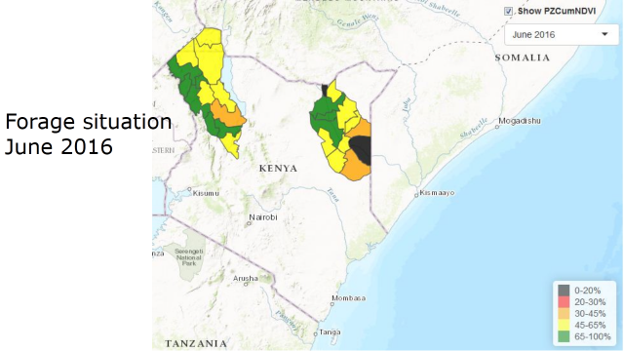
Long Rains Season cumulative Report: (Mar, April, May and June, 2016)
Two insurance units in Wajir (Diff and Bute) have triggered
Unit Area of Insurance | No. of Beneficiaries | Payout Amount
DIFF | 179 | 2,295,496
BUTE | 96 | 1,231,104
TOTAL | 275 | 3,526,600

Slide 18
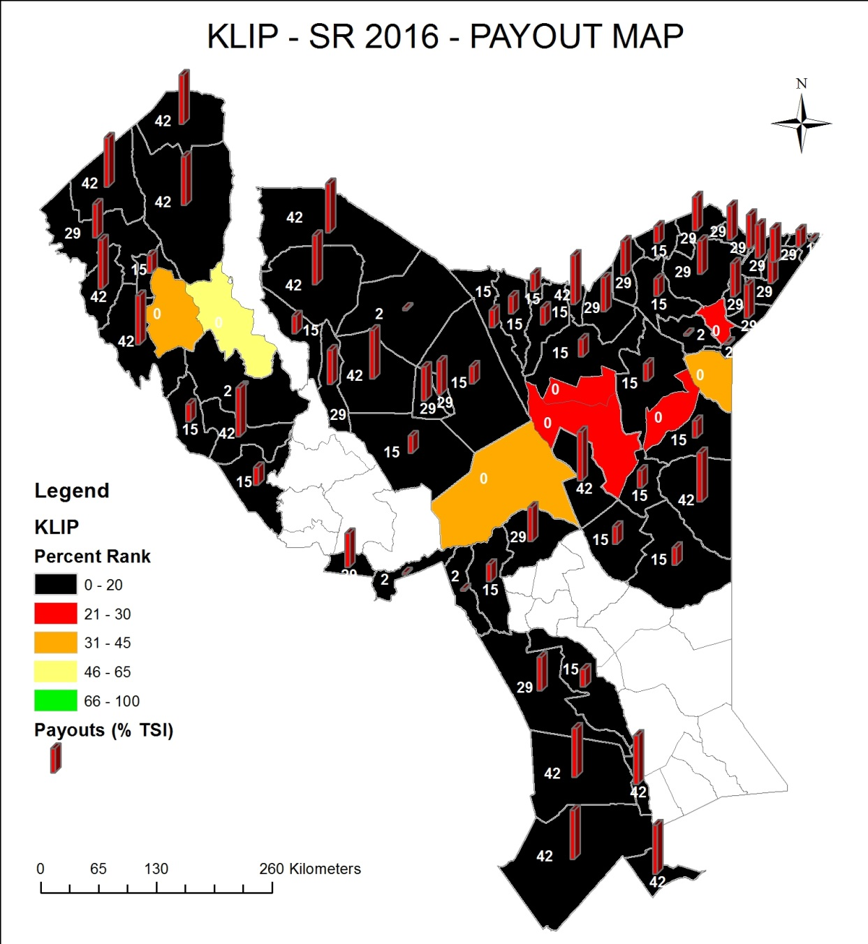
PAYOUT MAP – Short Rains 2016
SUMMARY PAYOUTS
Units paid | 62
Units non-paid | 8
Average Payout | 25%
Nr. Units - Full Payout | 16
Nr. Units - Approx 30% | 18
Nr. Units - Approx 15% | 21
Nr. Units - Min Payout | 7
Total payouts
KES 215M
Beneficiaries receiving payouts 12,000
Total Number of beneficiaries 14,000

Slide 19
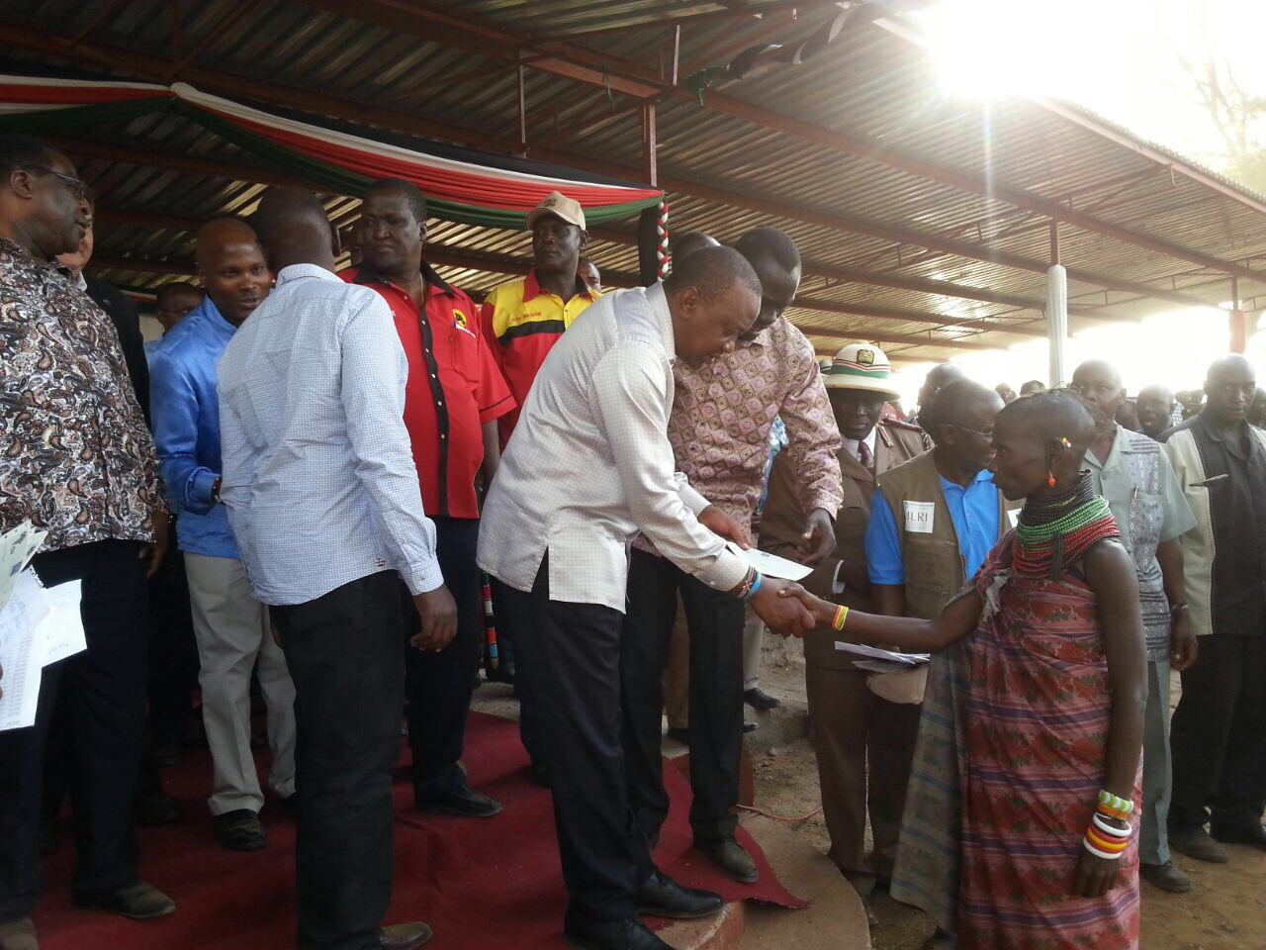
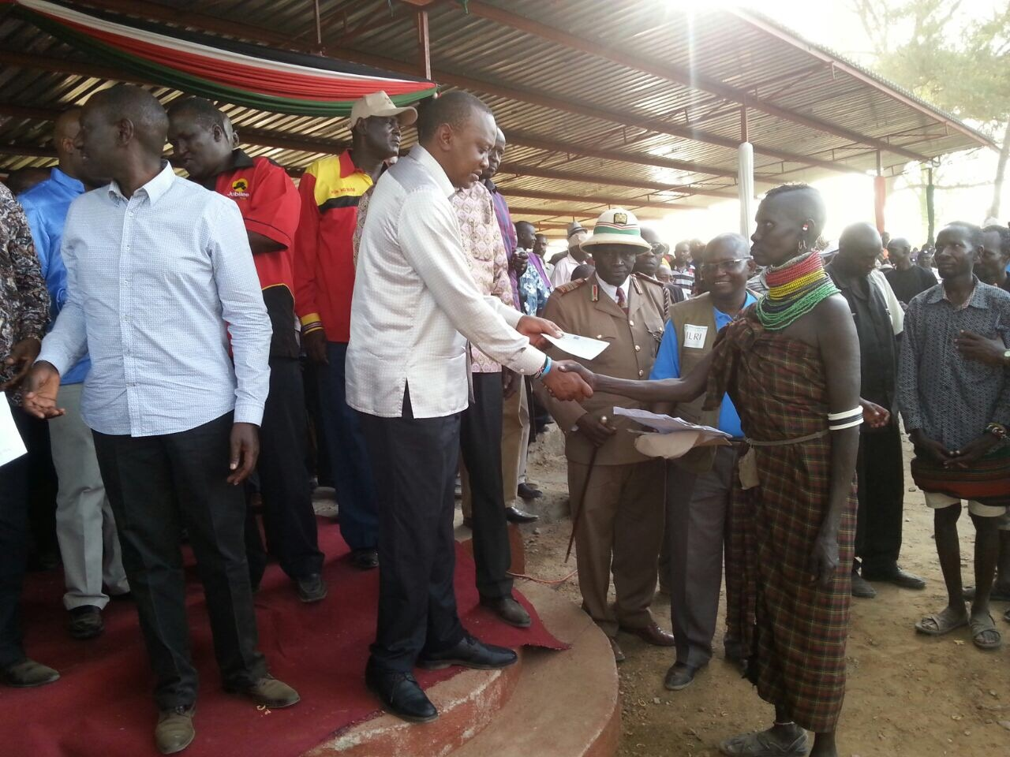

Slide 20
Total Sum Insured per beneficiary (KES) | 70,000
Allocation sum insured to short rains (LRS) | 58%
Maximum Payout/ Beneficary (KES) | 40,600
Minimum Payout/ Beneficiary (KES) | 12,600
Beneficiaries receiving payouts | 12,064
Total amount of payouts | 319,191,600
Total Number of beneficiaries | 14,010

Slide 21
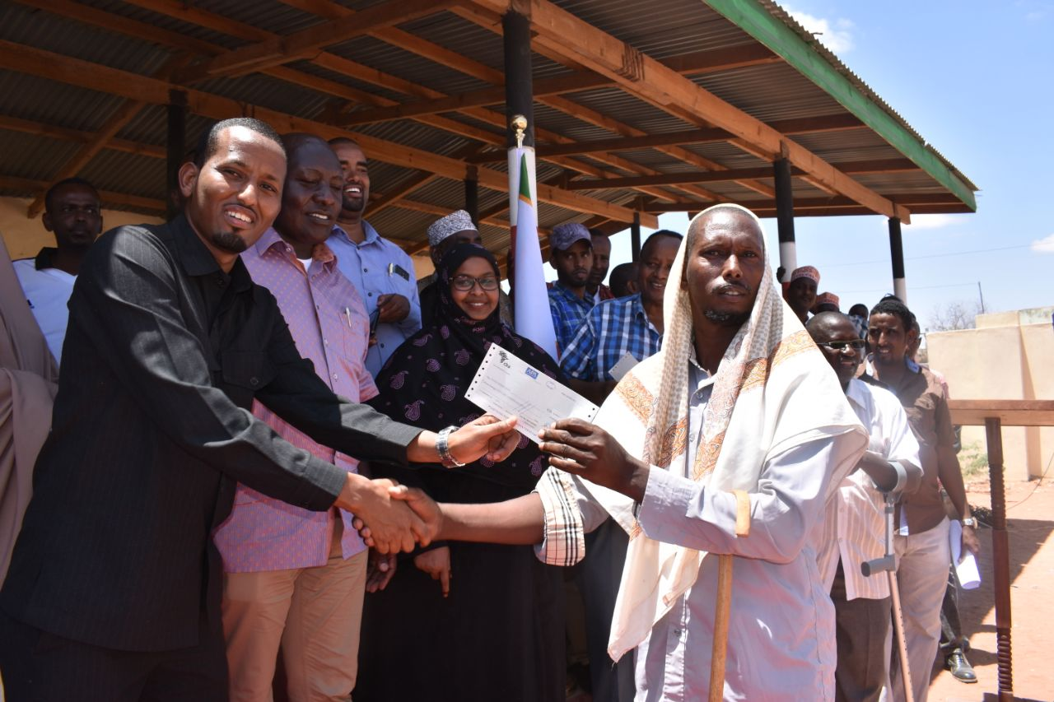
Presentation of cheques for KLIP payouts, October 2017

Slide 22
KLIP SR PAYOUT AMOUNT AND NO. OF BENEFICIARY
County | Registered Beneficiaries | Beneficiaries Receiving Payouts | Total Payout Amount
Turkana | 2502 | 0 | -
Wajir | 2510 | 1077 | 10,827,107
Mandera | 2000 | 1485 | 19,326,046
Marsabit | 2500 | 1112 | 10,100,581
Isiolo | 2000 | 1547 | 33,898,801
Tana River | 2500 | 2500 | 66,695,958
Garissa | 2000 | 1603 | 33,065,413
Samburu | 2000 | 341 | 1,193,500
Total | 18012 | 9665 | 175,107,406

Slide 23
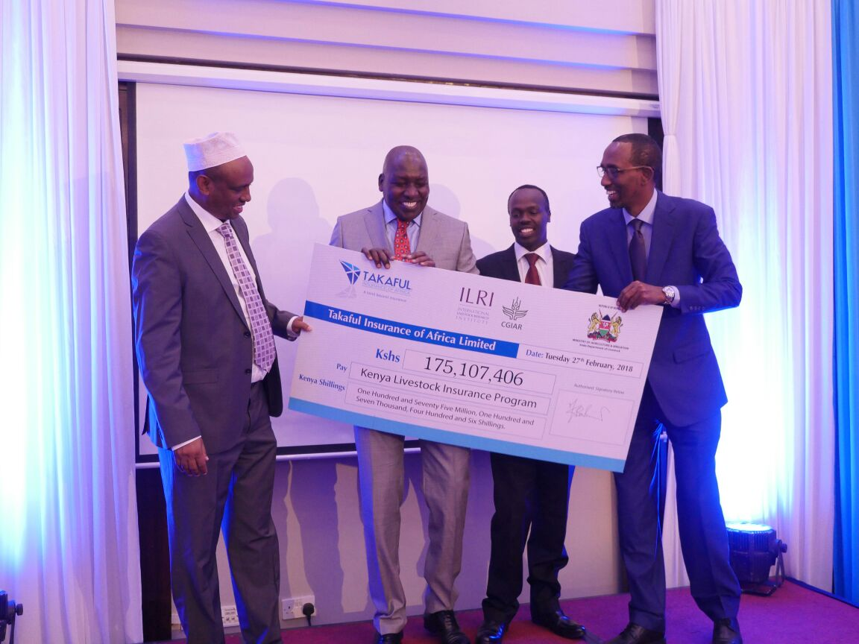

Slide 24
KLIP Activities
Capacity building and awareness creation on index insurance among key stakeholders to enhance investment in insurance and its uptake;
Entrenching livestock insurance implementation structures at the two levels of Government;
Establishing a livestock insurance electronic system for managing the beneficiaries data ;
Streamling Payouts responsibilities.
Developing local capacities in calculating agent services
Sustainability: Development of partial subsidy to purely commercial products.
Continuous research for product fitness

Slide 25
Expected Outcomes and impacts of KLIP implementation
Contribution to food security and building resilience in pastoral communities through the following:
Bring 40,000 households into insurance cover in 14 ASAL Conties.
A total of 200,000 TLUs; worth Kshs. 12 Billion will be protected against adverse effects of droughts
A reduction in likelihood of distress livestock sales (selling livestock to provide quick income in times of hardship),
A reduction in likelihood of reducing the number of meals as a coping strategy; and a 33 percent reduction in reliance on food aid.
Insured households will generate higher milk production and incomes and have better child nutrition than non-insured households.
Insured herders will most likely reduce their overall herd size, an indication they no longer feel the need to maintain surplus animals as a hedge against drought losses.

Slide 26
A functional Public private partnership
Roles of National and County Governments
Creation of conducive policy and business environment;
Coordination
Resource mobilization;
Capacity building of stakeholders;
Private sector mobilization;
Development of support infrastructure like sale yards, strategic feed store, ICT systems

Slide 27
County Governments
Extension/outreach services;
Data collection and management;
Selection of insurance beneficiaries;
Aligning programs to complement livestock insurance.
Role of Private Sector/Insurers/Reinsurers
Provision of Insurance cover
Awareness creation, Marketing, Recruitment of voluntary cover
Disbursement of payouts.

Slide 28
Challenges
Low funding levels
Low awareness creation and capacity building levels
Beneficiary data management – recruitment challenges (manual registers)
High premiums
Slow payout pathways

Slide 29
Lessons learnt and way forward
KLIP insurance products
To date: Gok Fully subsidized cover Going forward: Voluntary insurance services Partial subsidies Fully Voluntary/commercial products
Development of Livestock insurance implementation strategy and Policy

Slide 30
Lessons learnt and Way forward
Continued………
Sustainability: Development of partial subsidy to purely commercial products.
Establish a livestock insurance electronic system for managing the pastoralists data ;
Streamline Payouts responsibilities.
Develop local capacities in calculating agent services
Continuous research for product fitnes

