Slide 1
Index Insurance Implementation
Public/Private Partnerships – Kenya Experience

Slide 2
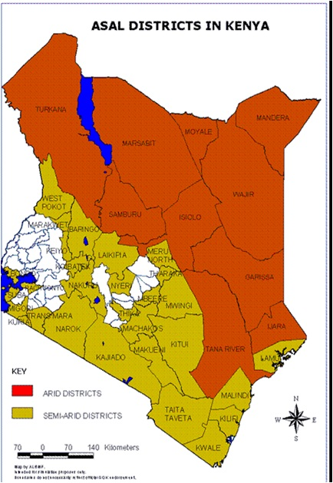
Region Covered by KLIP

Slide 3
Focus Problem Identification
Risk
Drought
Target
Pastoralists
Product
Forage Scarcity

Slide 4
Why Focus on Drought?
 | Cause of Loss | Percent Loss
1 | Drought | 80%
2 | Disease | 15%
3 | Others | 5%

Slide 5
Total Potential Payout Overtime
Updated to December 2017
Pure Risk Premium Rate (Average Annual Loss): 12.34%
Historical Maximum Loss (Max Annual Payout): 44.75%
No of policies: 18,000
Animals insured: 90,085
Total Sum Insured: 1,261,193,603

Slide 6

Asset (Animals) Covered

Slide 7
Contract: Forage Scarcity
Green | Good forage availability that represents above 65 percentile over a long period. This is above normal and stable forage condition.
Yellow | Forage condition falls between 45 to 65 percentiles. The forage situation is positive but consistently worsening.
Orange | Forage condition is between 30 and 45 percentile. The division in question is under considerable stress but not yet serious.
Red | Forage condition is between 15 – 30 percentiles. Drought situation is serious but not yet classified as severe. Indemnity payout will not be triggered.
Black | Severe drought condition. Forage condition represents worst 15 percentile. Indemnity payout will be triggered if conditions persist throughout the season up to the potential payout period.

Slide 8
A Shared Risk Approach
Managing Drought Risk
National
Government
County
Government
Private Sector
Pastoralist
Development Partners

Slide 9
Managing Drought Risk
National
Regional
Voluntary

Slide 10
KLIP Cumulative Premium vs Payout

Slide 11
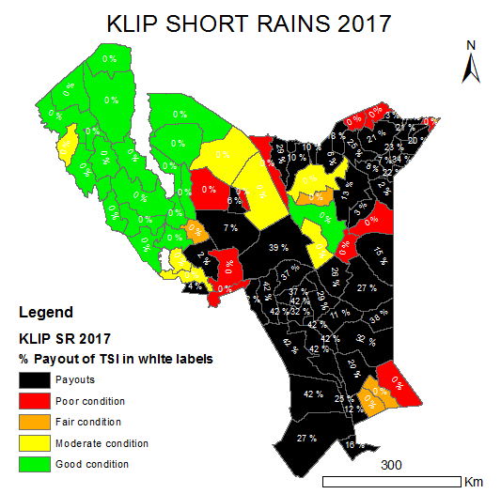
Shared Risk Approach
Managing Drought Risk
National
Government
County
Government
Private Sector
Pastoralist
Development Partners

Slide 12
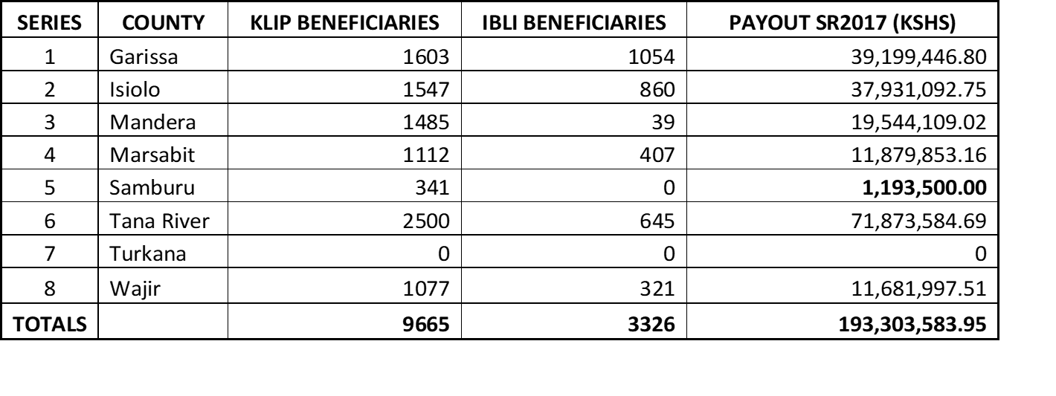
SR2017 Combined KLIP/Voluntary Payout

Slide 13
Desirable Premium Contribution Model
Increasing Over Time
Voluntary
Contribution
Reducing Over Time
Subsidy
Support

Slide 14
Channel Distribution Model
Manager
Regional Leader
C1
C2
Regional
Leader
C4
Corporate Level (1)
Cluster Leader (2)
Coordination (8)
S1
S2
C3
Supervision (32)
S3
S4
Community Agent (500)
A1
A2
A3
A4

Slide 15
Index Channel Experience
Community Agent
500
Coordination
8
Supervision
32
Corporate
Cluster
Leader
2
1

Slide 16
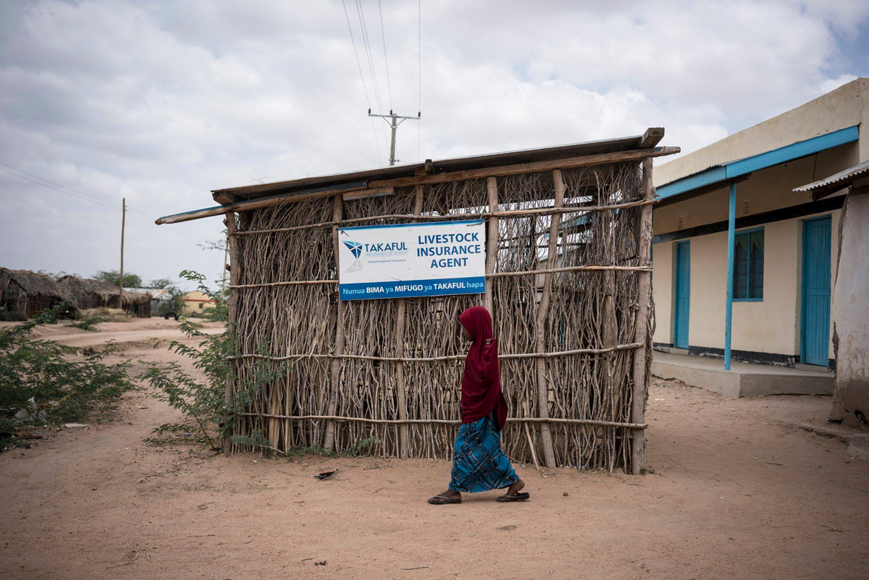
Community Based Agency Model

Slide 17
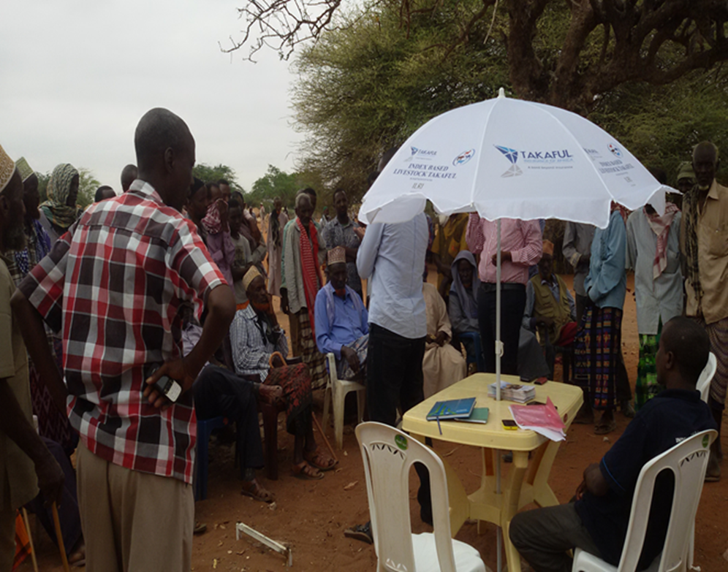
Community Based Agency Model

Slide 18
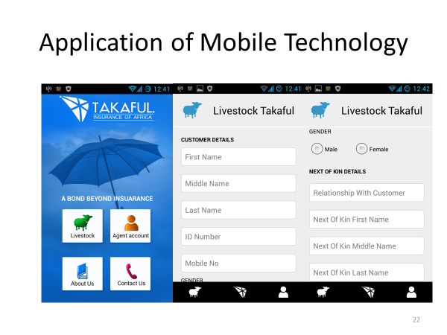

Slide 19
Collaboration with Stakeholders
Community Elders/Opinion Leaders
Religious Leaders
County and Local Chiefs
Members of County Assembly
Members of Parliament
County Livestock Department
Sub-County & Ward Administrators
Livestock Extension Officers
Local Community Media Houses

Slide 20
Partnership in Product Design
Reliability of Data (Product)
Reachability (Presence)
Acceptability (Community)
Affordability (Price)
Difficulty of Achieving Critical Mass (Volume)
Inclusive Nature of Claims Trigger
Need for Geographic Diversity

Slide 21
Partnership in Public Education
Joint Investment in Public Education

Slide 22



